Slide 1
Entering Final Grades
in Populi

Slide 2
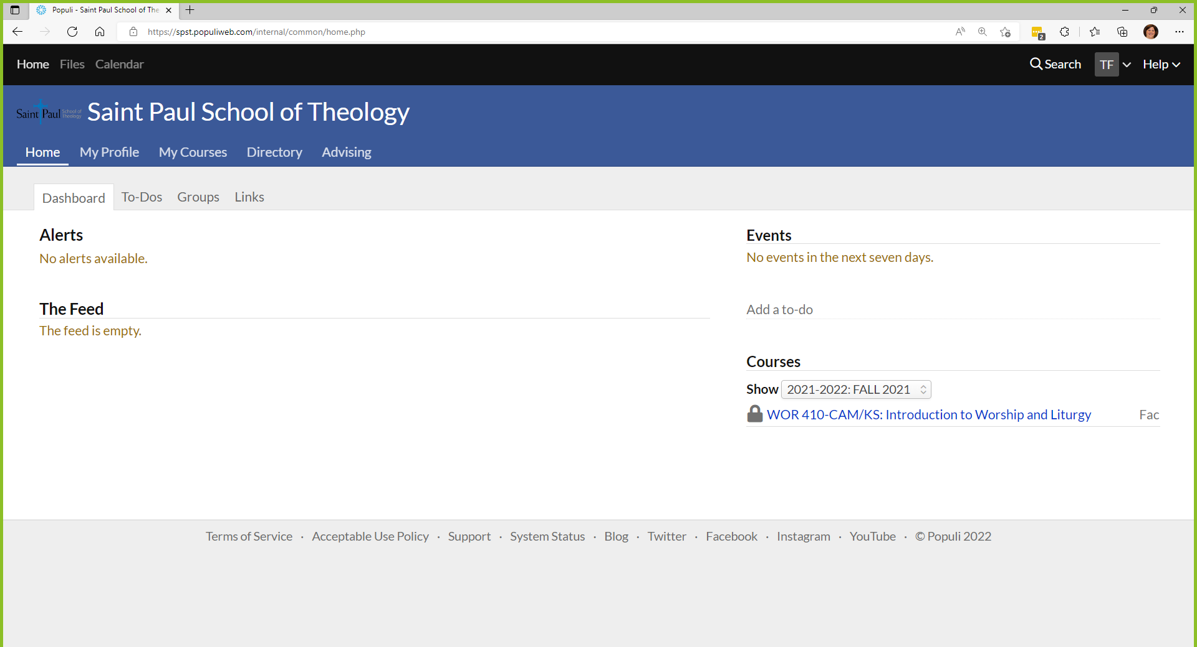
Log into Populi
https://spst.populiweb.com/
Click on My Courses

Slide 3
Click on the course

Slide 4
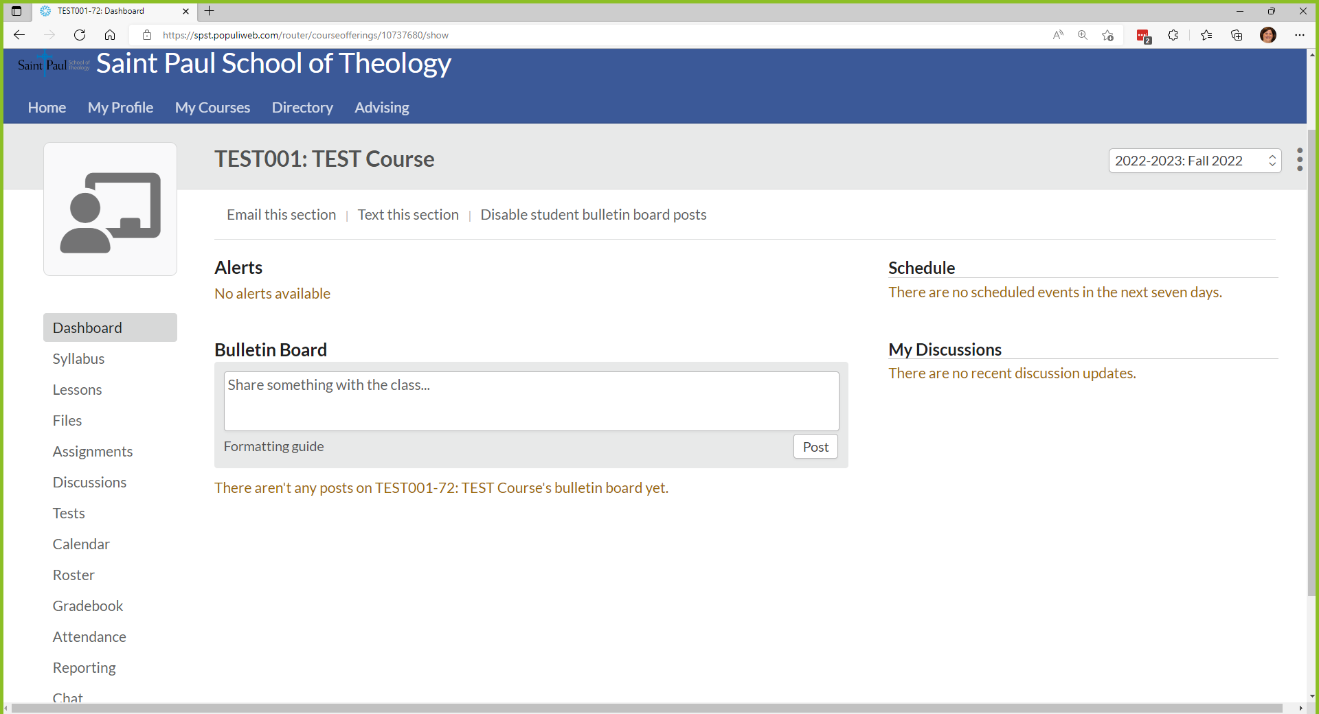
Click on the Gradebook

Slide 5
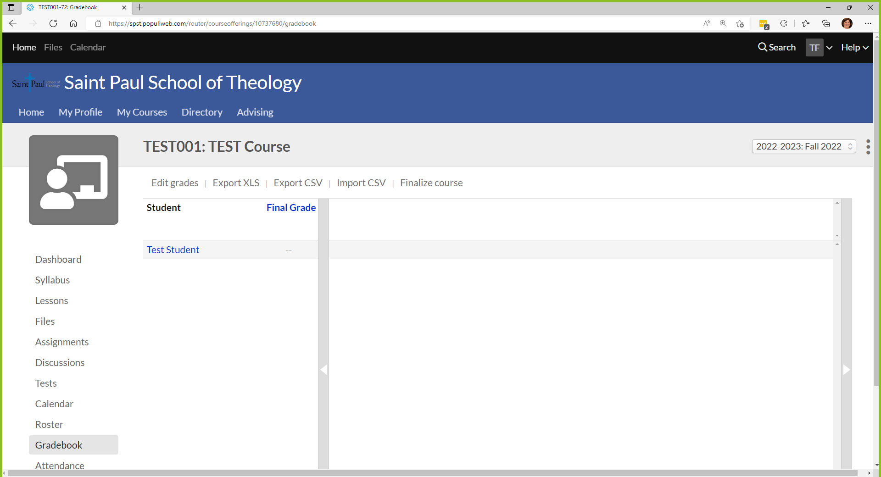
Click on Final Grade

Slide 6
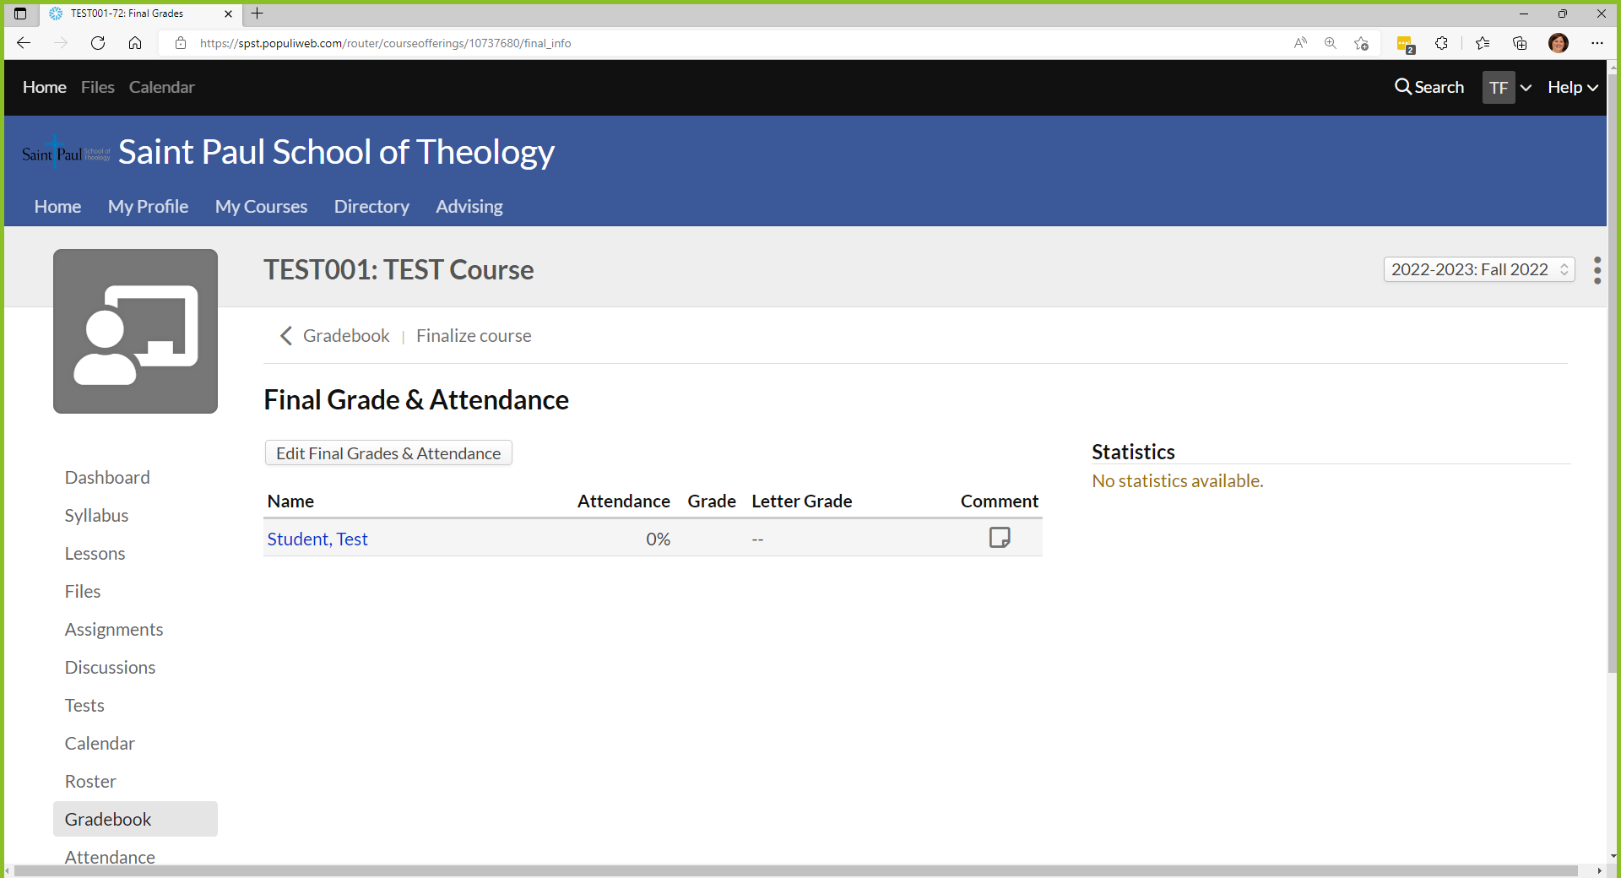
Click on Edit Final Grades…

Slide 7
Click on the Grade dropdown arrows

Slide 8
1) Select the grade
2) Click Save

Slide 9
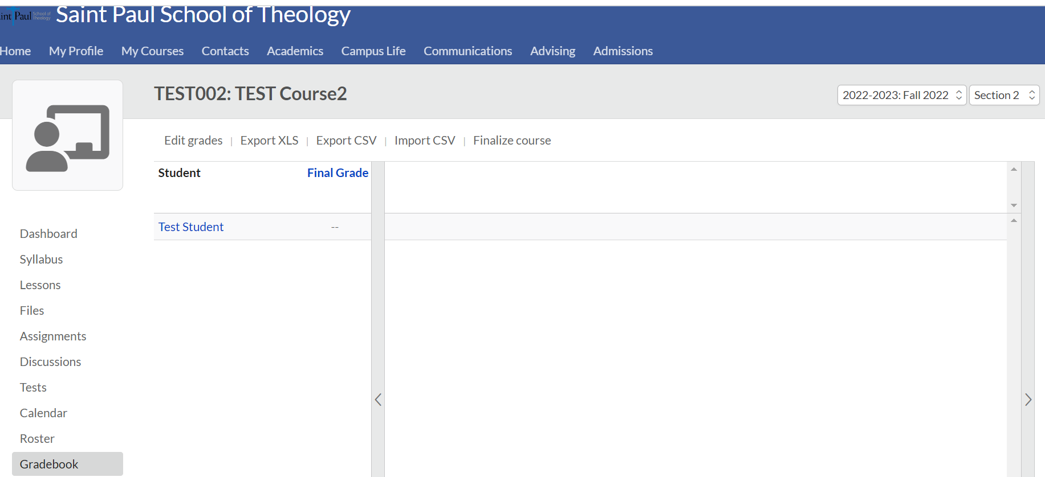
Reminder:
Save each section
before switching to the next.
DO NOT FINALIZE COURSES!

Slide 10
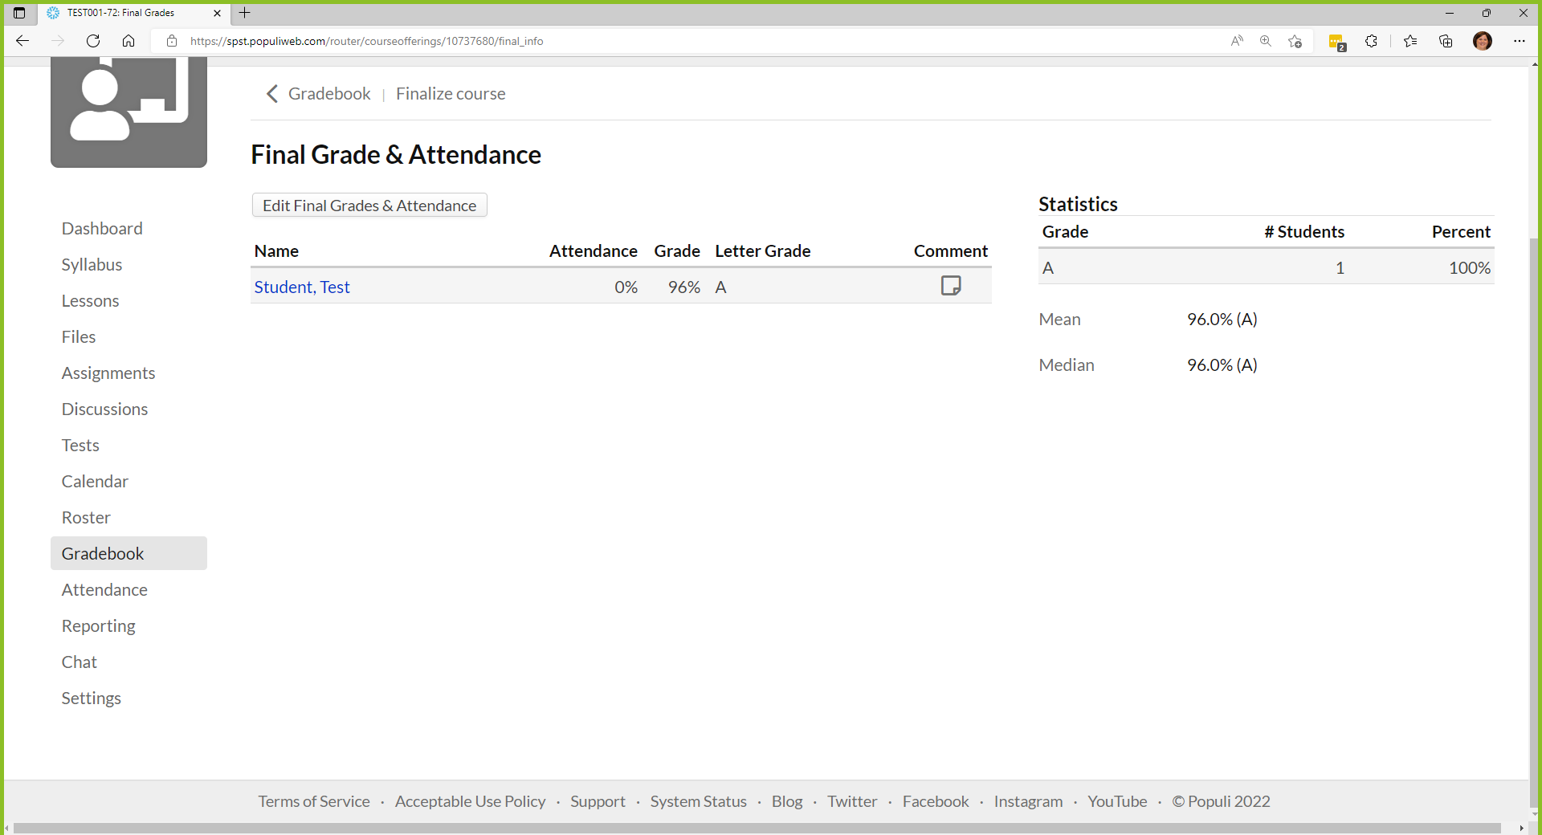
You’re Finished!
DO NOT FINALIZE COURSES!

